Slide 1
Port Scanning-Zenmap

Slide 2

Zenmap Tool
Zenmap is the official graphical user interface (GUI) for the Nmap Security Scanner.
It is a multi-platform, free and open-source application designed to make Nmap easy for beginners to use while providing advanced features for experienced Nmap users.
Scan results can be saved and viewed later.
Saved scans can be compared with one another to see how they differ

Slide 3
Zenmap Tool- Advantages
Interactive and graphical results viewing
Comparison
Convenience
Repeatability
Discoverability-
Advantages
Arrange its display to show all ports on a host or all hosts running a particular service
Show the differences between two scan
Run a scan, see the results, and then decide whether to save them
easy to run the exact same scan more than once
helps beginners learn and understand what they are doing

Slide 4
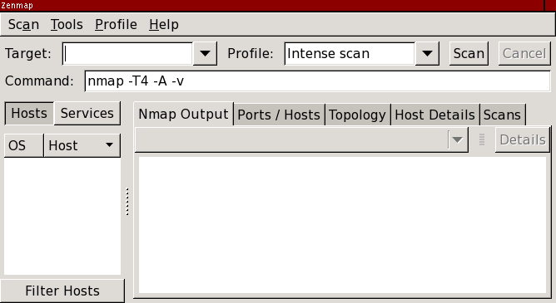
Zenmap
Zenmap Main Window

Slide 5

Zenmap
Target and profile selection
Target- IP or domain
Profile- Different scans, as profile changes, commands also changes accordlingly

Slide 6
Zenmap
Scan Aggregation
Zenmap has the ability to combine the results of many Nmap scans into one view, a feature known as scan aggregation.
When one scan is finished, you may start another in the same window.
When the second scan is finished, its results are merged with those from the first.
The collection of scans that make up an aggregated view is called a network inventory.

Slide 7
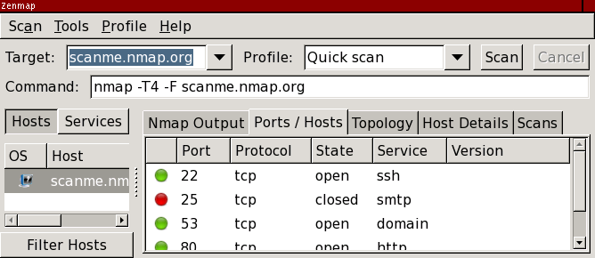
Zenmap-2 scans
1st Step: Run a quick scan against scanme.nmap.org

Slide 8
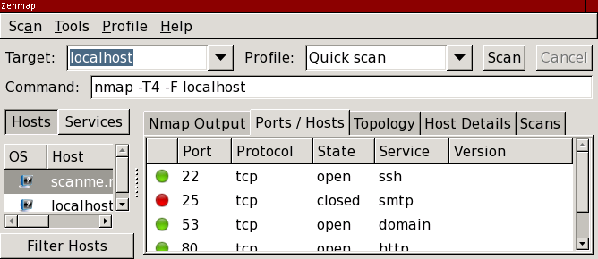
Zenmap- 2 scans
2nd step: quick scan against localhost
Now results for both scanme and localhost are shown.

Slide 9
Zenmap- 2 scans
Can we scan two hosts in Nmap??

Slide 10
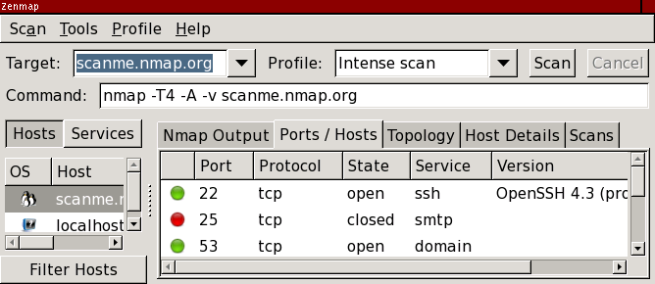
Zenmap
Intense Scan
Shows penguin-means detected OS as Linux
one of its services has been identified.
Several scans may run concurrently. As each one finishes its results are added to the inventory.

Slide 11
Zenmap-Result
Each scan window contains five tabs which each display different aspects of the scan results.
They are:
“Nmap Output”,
“Ports / Hosts”,
“Topology”,
“Host Details”, and
“Scans”.

Slide 12
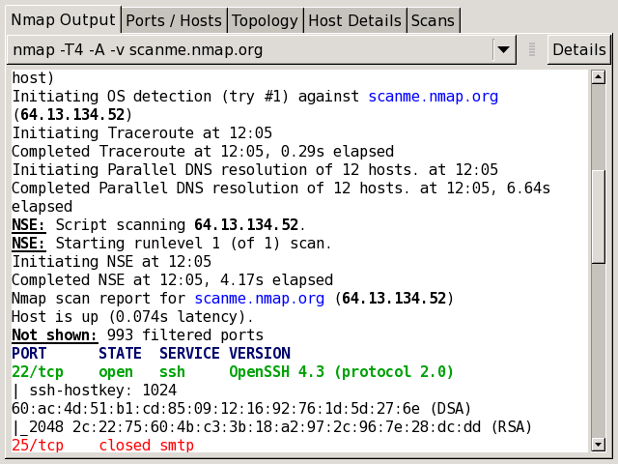
Zenmap-Result
“Nmap Output” tab
open and closed ports are displayed in different colors

Slide 13
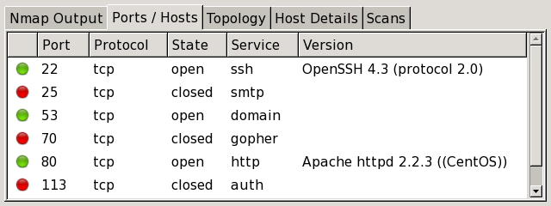
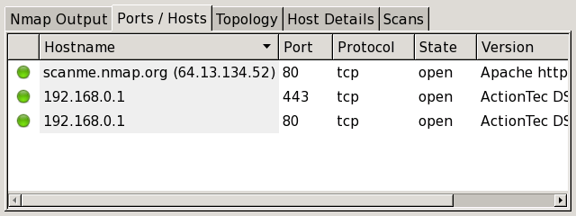
Zenmap-Result
The “Ports / Hosts” tab
Host Tab-host is selected, it shows all the interesting ports on that host along with version information when available
Port Tab-all the hosts which have that port open or filtered

Slide 14
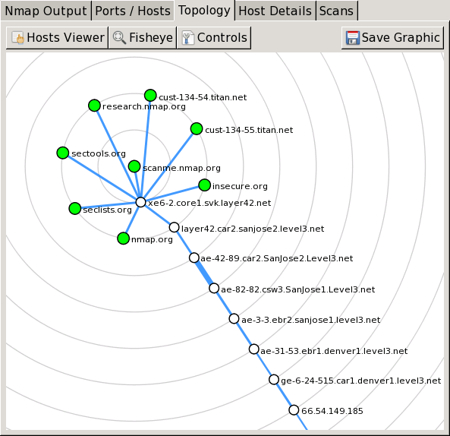
Zenmap-Result
“Topology” tab
interactive view of the connections between hosts in a network.
Hosts are arranged in concentric rings.
Each ring represents an additional network hop from the center node.
Clicking on a node brings it to the center. Because it shows a representation of the network paths between hosts,
benefits from the use of the --traceroute option.

Slide 15
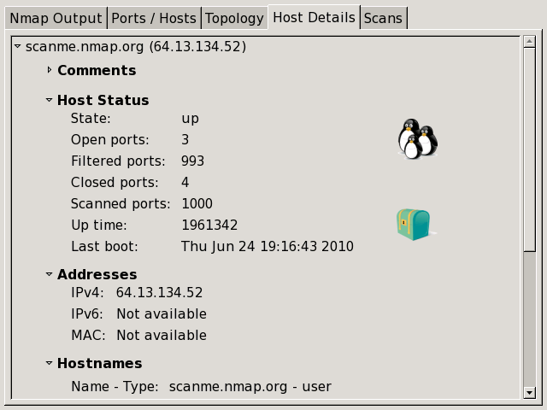
Zenmap-Result
The “Host Details” tab
breaks all the information about a single host into a hierarchical display.
Show the host's names
addresses,
its state (up or down), and
the number and status of scanned ports.
The host's uptime,
operating system,
OS icon
etc

Slide 16
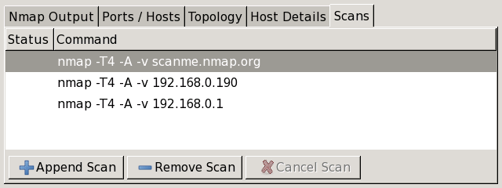
Zenmap-Result
The “Scans” tab
shows all the scans that are aggregated to make up the network inventory

Slide 17
Zenmap GUI-Task 20 mins
Download the zenmap tool and try its basic commands
Create a word file and write command and paste the screenshots.
Task
Zenmap is also inbuilt tool in kali
Enter IP/domain
Find the difference between 2 hosts information
Merge two scans
Intense scan
Quick scan

Slide 18
Assignment
How to run scripts in Zenmap
How to find the is firewall enabled or disabled in Zenmap
Can we perform IP or MAC spoofing in Zenmap

Slide 19
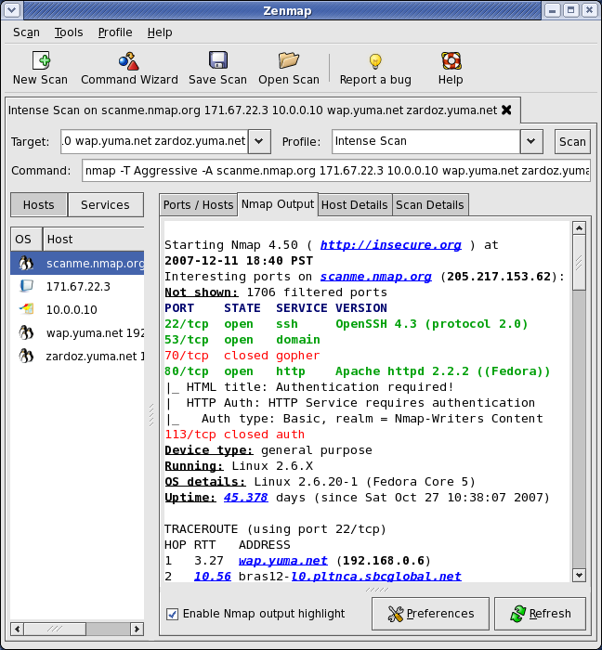
Screenshots of Commands
Intense scan

Slide 20
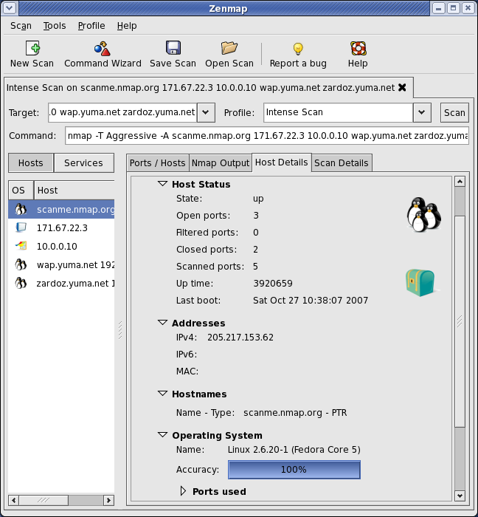
Screenshots of Commands
Intense scan

Slide 21
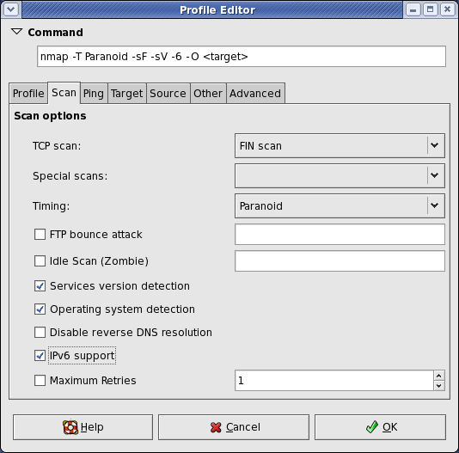
Screenshots of Commands
Intense scan

Slide 22
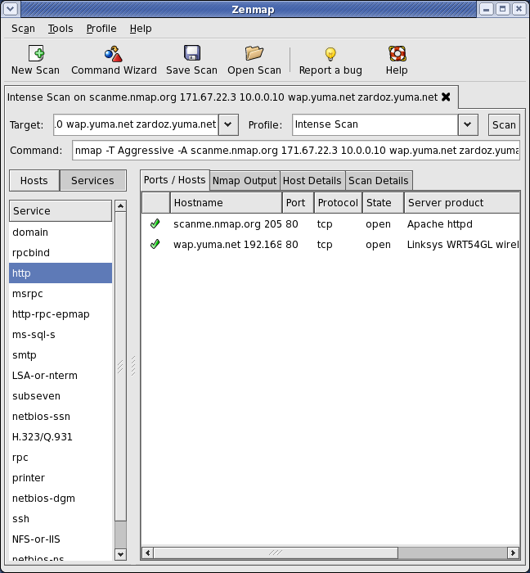
Screenshots of Commands
Intense scan

